Slide 1
Employee Retention Data Analysis
John Cedrick Napa

Slide 2
Table of contents
01
02
03
Project Overview
Data Analysis
Machine Learning

Slide 3

Project Overview
Statement of the Problem:
Low Employee Retention of Salifort Employees
Purpose of the Analysis:
Understand the factors affecting employee retention and decrease the turnover rate of Salifort Motors employees.
Main Stakeholders:
Salifort Motor Human Resources Department
Senior Leadership Team

Slide 4
Project Overview
Goals:
Determine key factors affecting employee retention
Create a predictive model to guide the business how to proceed and tackle the problem.

Slide 5
Data Overview
Factors Evaluated:
Satisfaction level
Previous evaluation score
Number of Projects
Tenure
Promotion
Departments
Salary

Slide 6
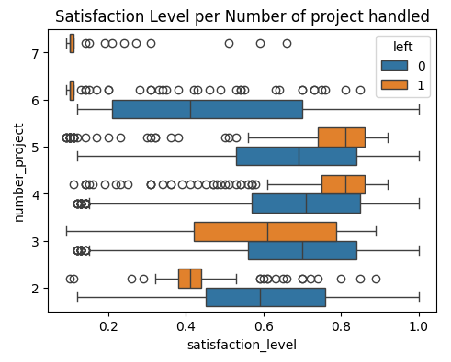
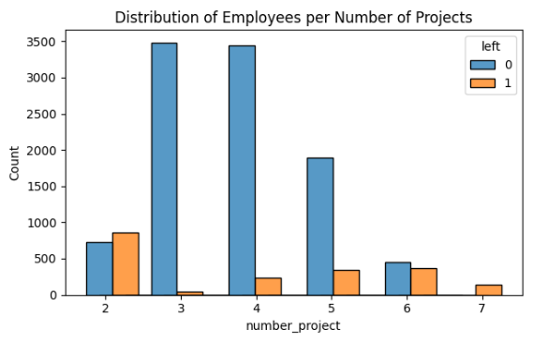
Data Analysis
Employees who are handling 7 projects at a time all left with a very low satisfaction score
3-5 projects showed acceptable satisfaction level scores and employee retention
Satisfaction Level

Slide 7
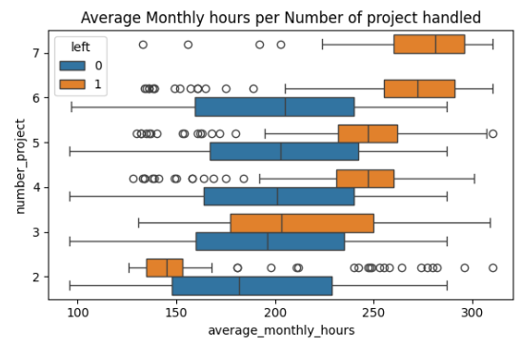
Data Analysis
Satisfaction Level
Employees who properly managed or practice acceptable working hours of about 200 hours stayed even with increasing work load
Majority of the employees who left were working more than 200 hours per month.
Inference:
People who left probably felt overworked and drained due to long working hours

Slide 8
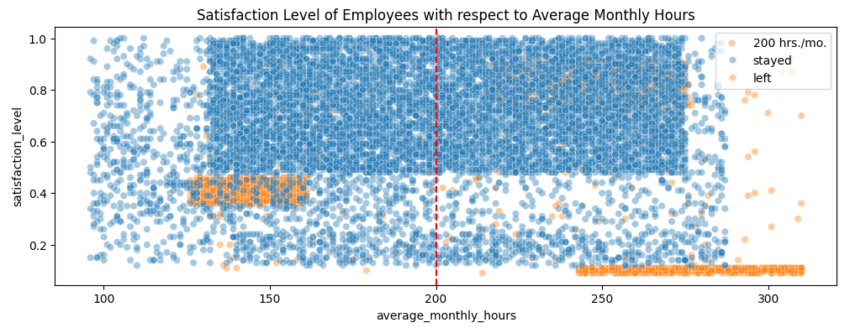
Data Analysis
Overworked employees who left had near to zero satisfaction scores
Group of employees with relatively low working hours left. Infered to be the employees who were fired
Satisfaction Level

Slide 9
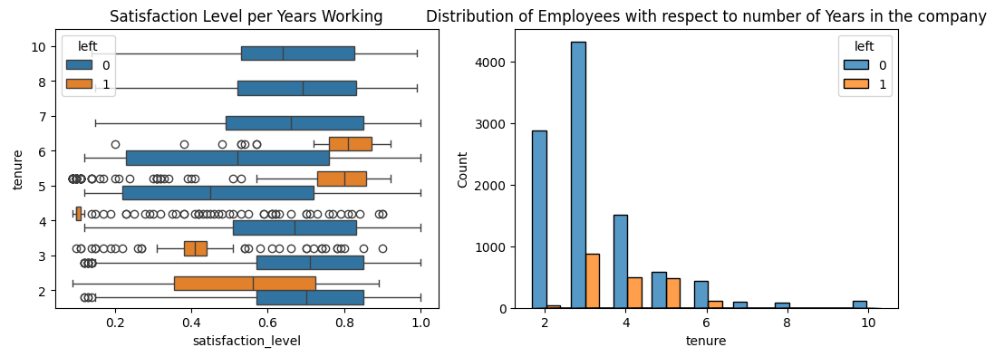
Data Analysis
Employees who has stayed for more than 7 years had high satisfaction level. Additionally, no employee left.
A group of highly satisfied employees with 5-6 years working experience in the company still left.
Majority of the employees who left were 3-5 years in the company
Tenure

Slide 10
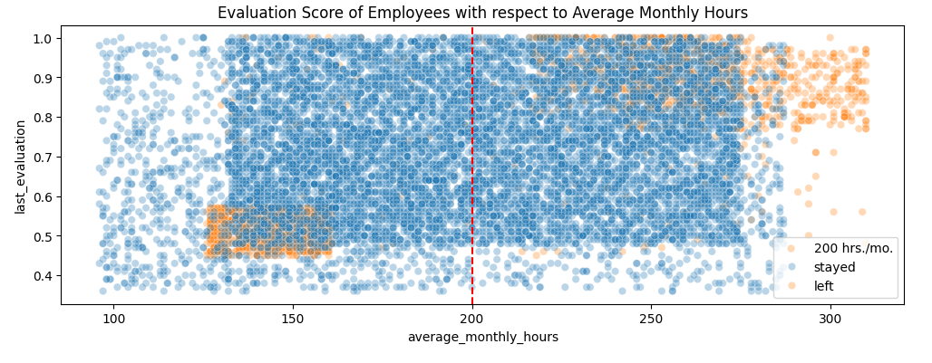
Data Analysis
Employees who has stayed for more than 7 years had high satisfaction level. Additionally, no employee left.
A group of highly satisfied employees with 5-6 years working experience in the company still left.
Majority of the employees who left were 3-5 years in the company
Evaluation Score

Slide 11
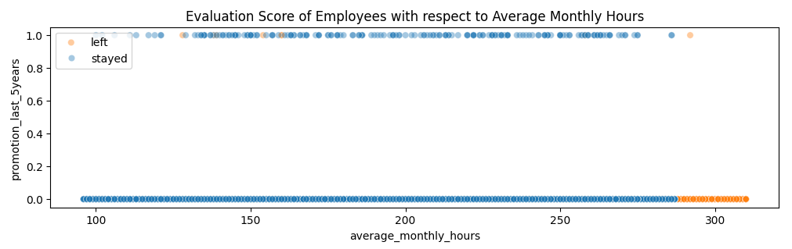
Data Analysis
Very few were promoted in the last 5 years (only 203 employees)
Promotion is not highly dependent on average monthly hours
Most people who left worked overtime
Promotion

Slide 12


Machine Learning Modeling
Logistic Binomial Regression
Decision Tree Classifier
Random Forest Classifier
XGBoost Classifier

Slide 13
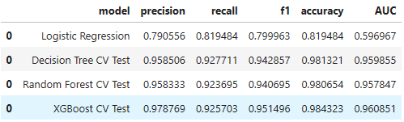
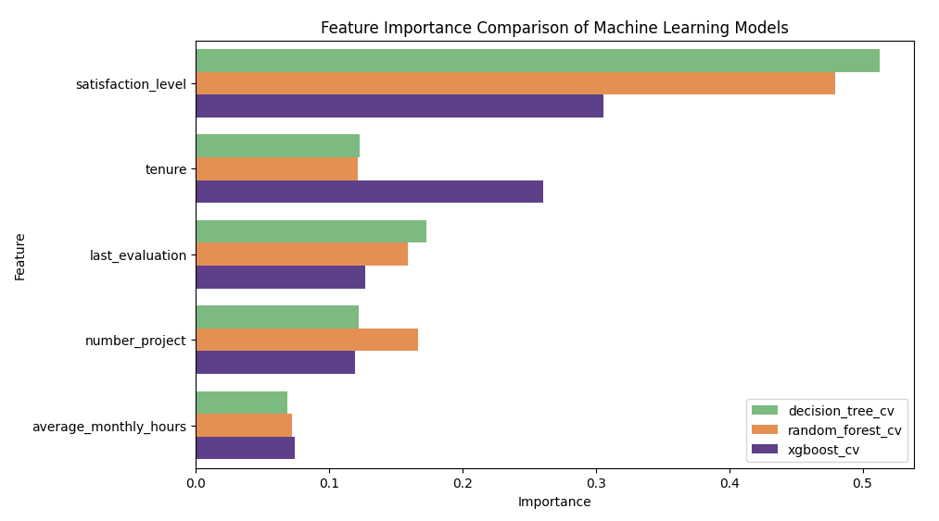
Machine Learning Modeling
The four machine learning models showed good metric scores with the XRBoost Model having the highest test AUC score 96.09%
Results of the feature importance indicates that the following had the greatest impact on whether an employee leaves or stays:
Satisfaction Level
Number of Projects
Tenure
Average Monthly Hours
Evaluation Score

Slide 14
Recommended Course of Action
Limit the number of projects assigned to an employee to 2-4 projects only.
Implement rules on work hours, either rewarding for working longer hours or cap the working hours to a reasonable amount keeping an eye on overwork signs.
Streamline evaluation scoring for employees putting more score weight on contribution and effort
Consider promotion after 4 years
Evaluate and discuss about company culture across different departments

Slide 15


